Slide 1

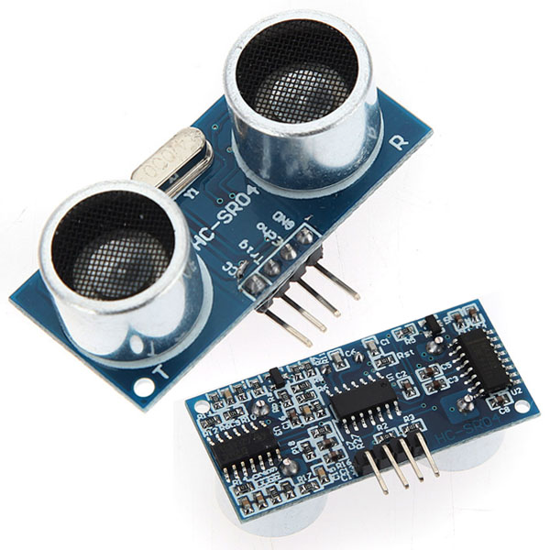
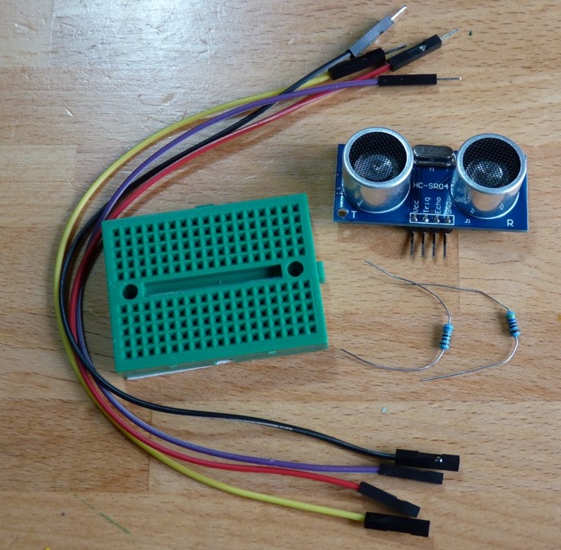
Raspberry Pi Distance Measuring
Cotswold Raspberry Jam
Saturday 28th January 2017

Slide 2
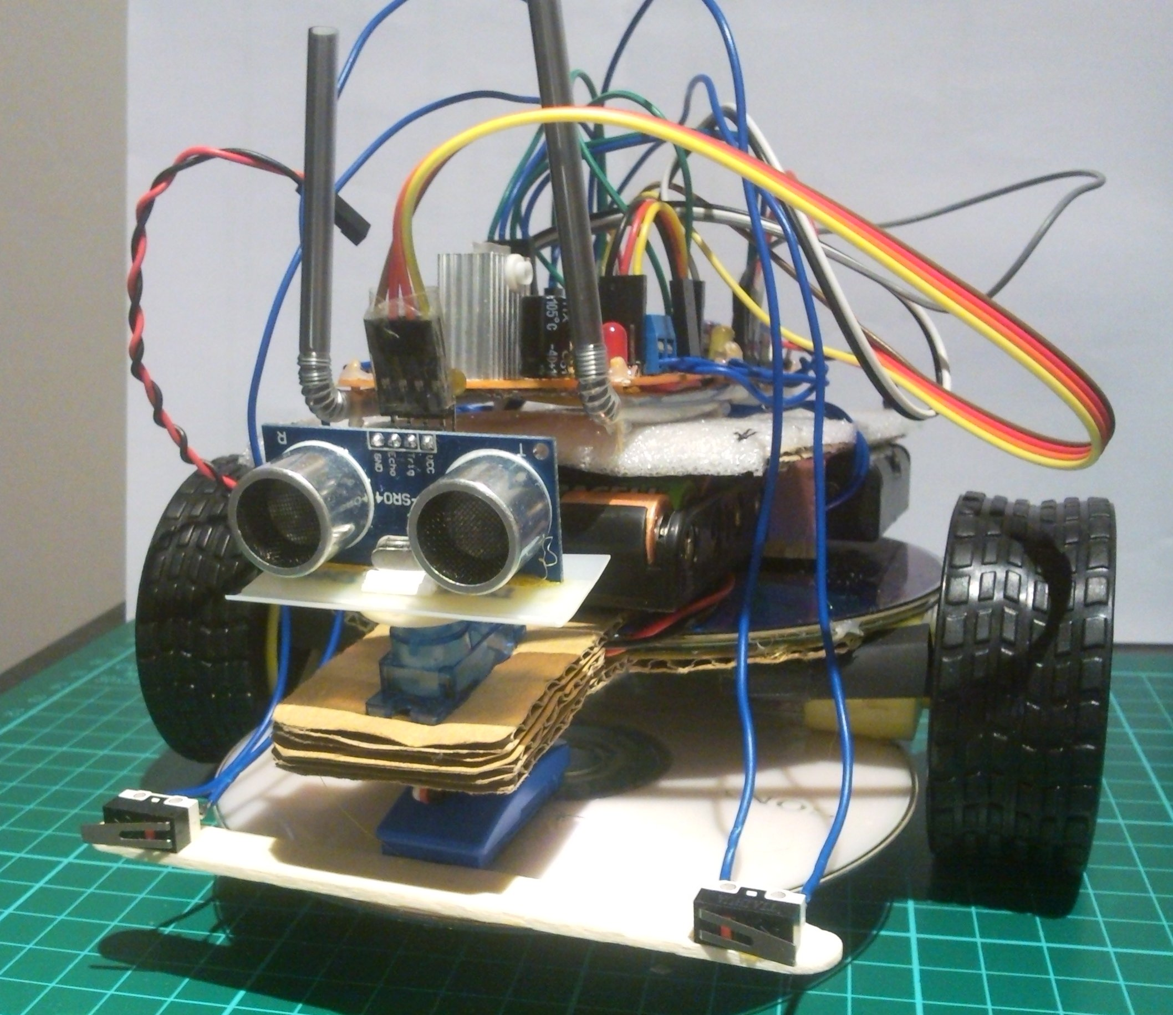
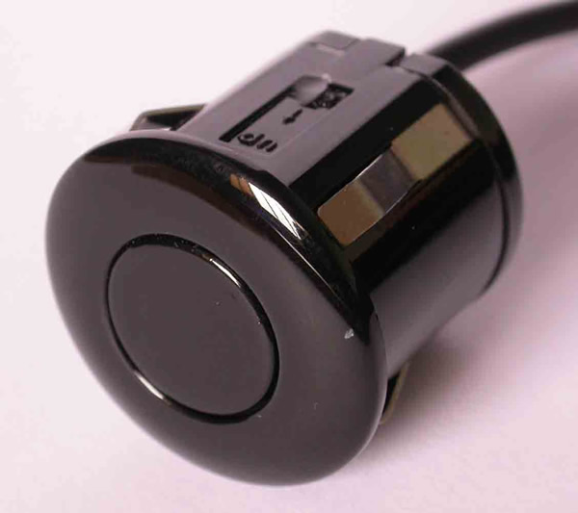
HC-SR04
Notes:
Cheap ultrasound measuring device
<CLICK> Used by robots to detect how far away they are from things
<CLICK> Based on the type of sensor used in car bumpers for parking sensors

Slide 3
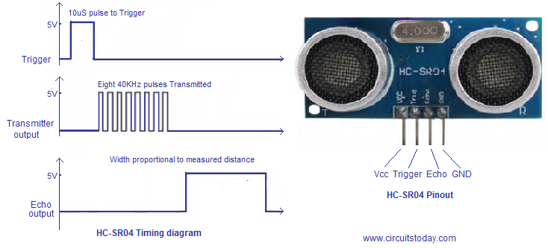
How does it work?
Notes:
<CLICK> To make the sensor take a measurement the Trigger line is held high for 10uS
<CLICK> The device then takes 8 readings sending out an ultrasound pulse and listening for a reply to each of them
<CLICK> Then the sensor holds the Echo pin high for an amount of time proportional to the distance it has measured
<CLICK> By measuring this time and doing a bit of maths we can easily work out the distance measured
We’re not going to do this in this tutorial but instead will leave the hard work to the GPIO Zero library

Slide 4
WARNING
The Raspberry Pi is a 3.3V device
The HC-SR04 is a 5V device
Connecting the HC-SR04 directly to the Pi WILL damage the Pi
☹☹☹☹☹☹☹☹☹☹☹☹☹☹☹☹☹☹
In the tutorial we use a “voltage divider” to change the 5V to 3V but this has to be wired correctly
So…

Slide 5
PLEASE
Make sure the Pi is turned off before you start wiring
And
Get your wiring checked before you turn the Pi on

